Slide 1
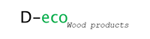
CASTELLANO LEGNAMI SRL
CASTELLANO LEGNAMI

Slide 2
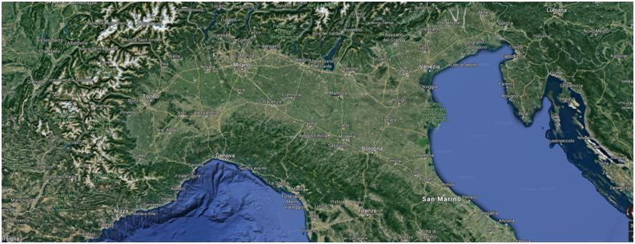
Our company Castellano Legnami s.r.l. has been involved in buying and selling wood and wooden products since 1988, both in Italy and abroad.
HEADQUARTER – Cavallermaggiore CN
PRODUCTION FACILITY – Vicenza

Slide 3
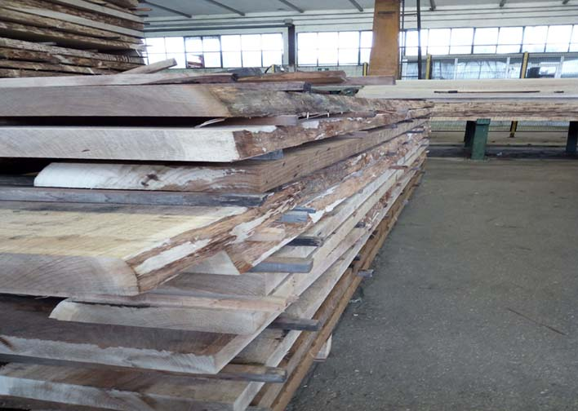
OUR PRODUCTS
SAWN TIMBER
Thanks to our long-lasting experience in the wood sector and to our privileged access to forest resources, we can offer slavonian durmast sawn timbers for all needs, harvested from the best forests in former Jugoslavia (Croatia in particular).

Slide 4
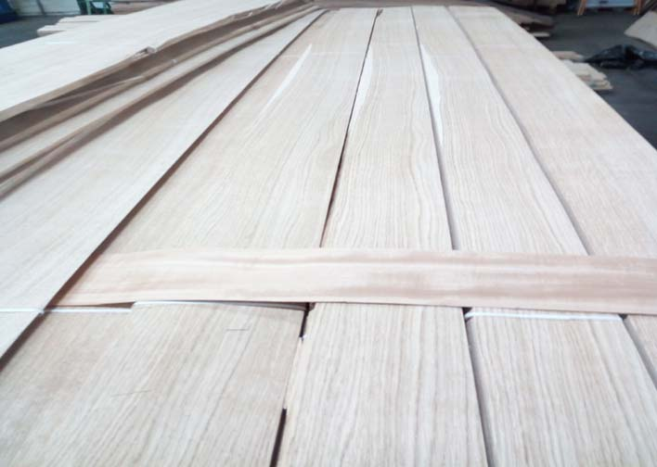
VENEERS
We have the opportunity to supply a wide range of veneers in several sizes and quality grades. We are always ready to show you and test the goods before collecting them, with the utmost transparency.

Slide 5
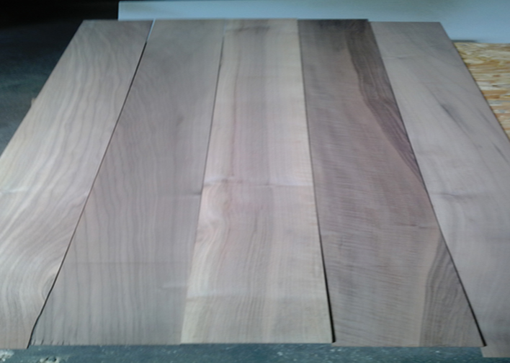
TOP LAYER
Besides the standard production from “new” wood, we can supply old durmast lamellas, obtained from wooden beams used in old constructions. These old beams are wisely processed to recover this old lumber, to which time and use conferred a particular harmony and value.

Slide 6
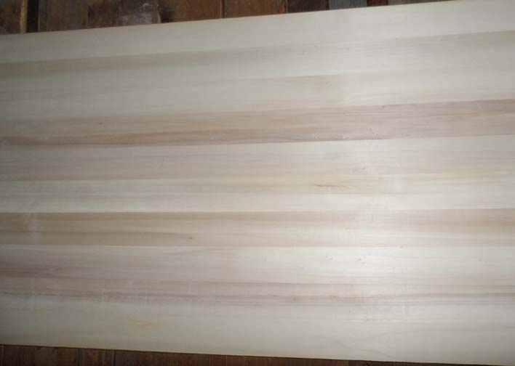
EDGED GLUED PANELS
Our poplar and paulownia panels come from the Middle East and we can offer them thanks to an exclusive supplier of proved experience and professionalism, with whom we have been working for more than ten years. The quality of these poplar and paulownia panels is nowadays well known and appreciated by the market.

Slide 7
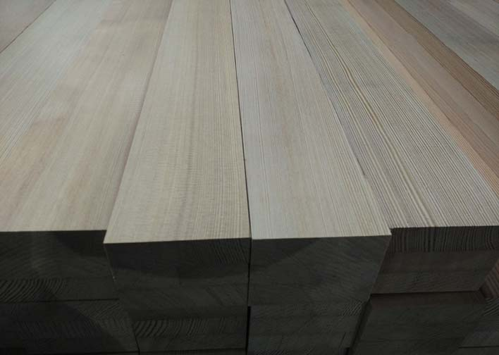
GLUED LAMINATED TIMBER
Our company is also involved into the commercialization of some semifinished products, including larch window scantlings. We can offer first quality larch window scantlings, with a very good price/quality ratio, from a very serious supplier tested over the years.

Slide 8
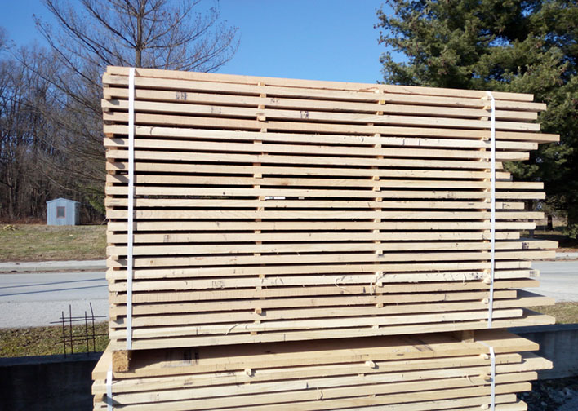
EDGED ELEMENTS
Thanks to our lost-lasting experience in the wood sector and to our privileged to forest resources, besides sawn timber, we can offer square edges elements of slavonian durmast (and other woods), which are quite demanded by furniture, panel and wood-flooring industry.

Slide 9
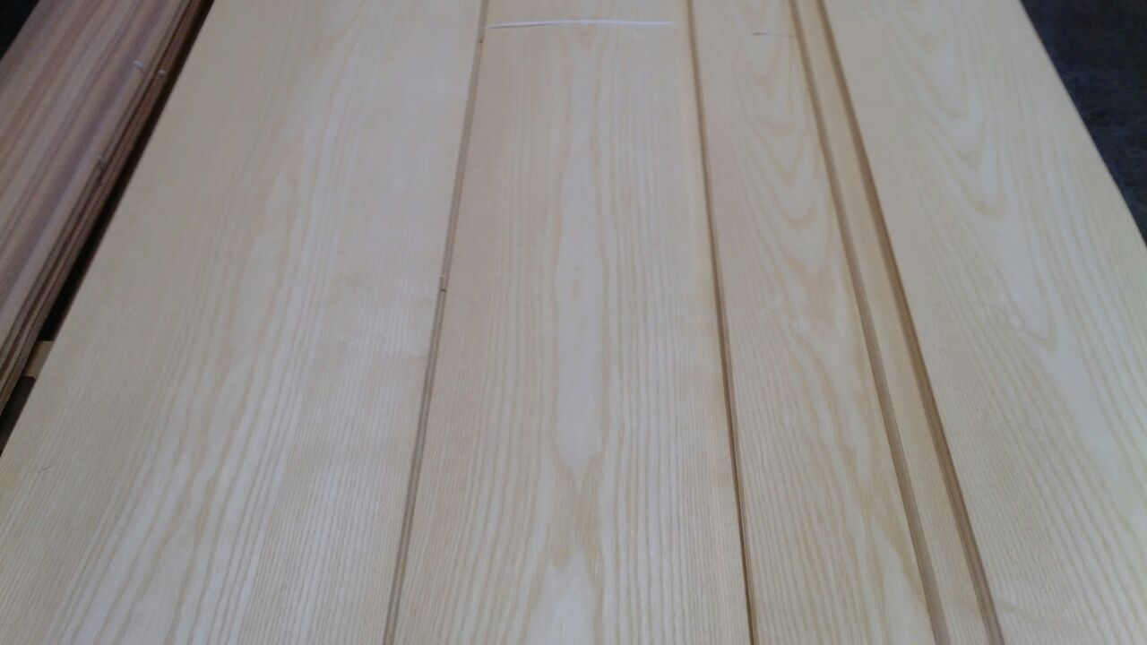
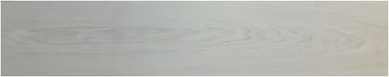
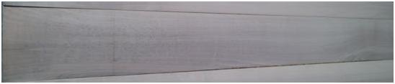



OUR SPECIALITY : TOP LAYER
OAK
ASH
EUROPEAN WALNUT
CHESTNUT
LARCH
OLD OAK BIO

Slide 10
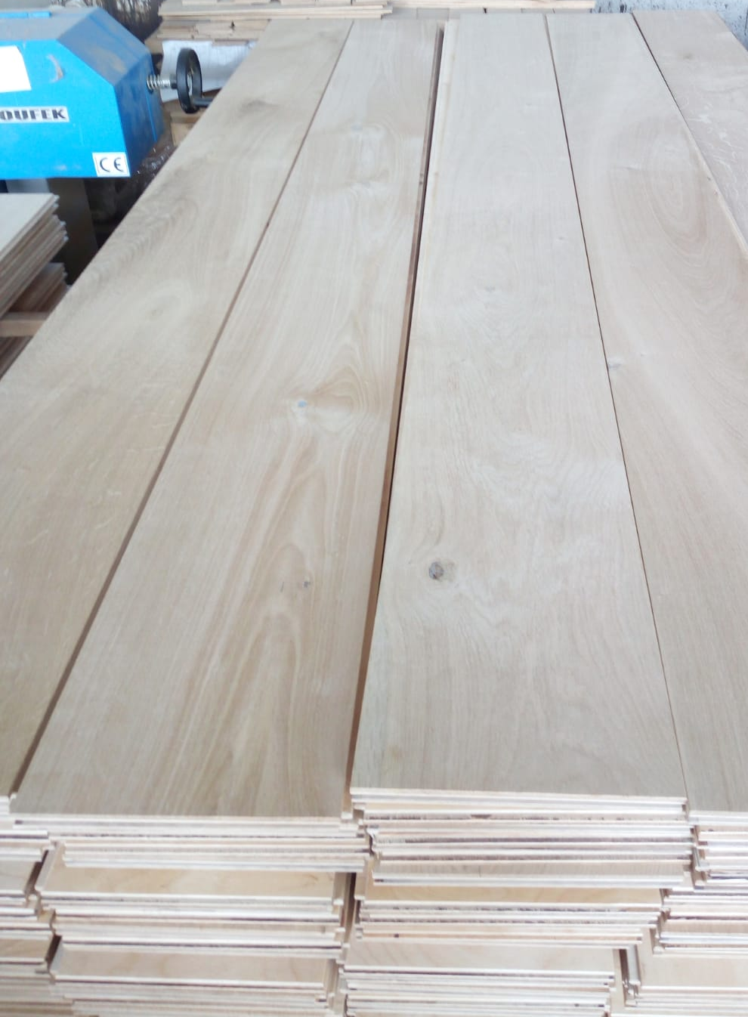
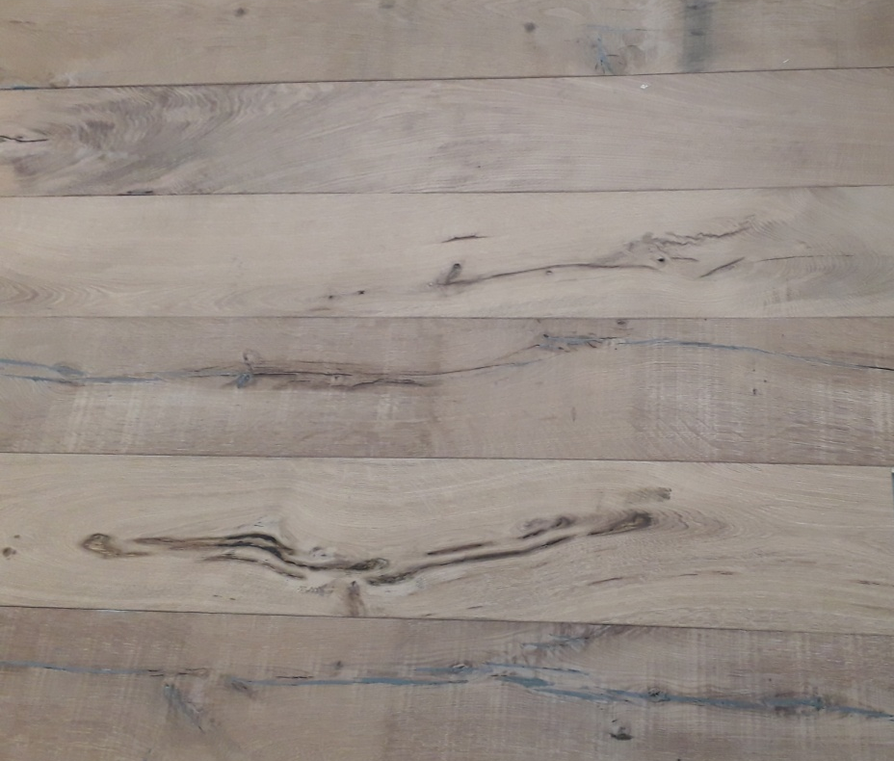
FINISHED PARQUET 2 LAYERS
Some examples
OAK PRE-FINISHED
OLD OAK BIO FLOOR

Slide 11
HOW WE WORK
CUSTOMER REQUESTS
GOODS TEST AT OUR FACILITIES OR TRIAL ORDER
ORDER CONFIRMATION
DELIVERY

